Slide 1
Exp10 Moments of Inertia
TA: Kevin Yi-Wei Lin
Email: kiln@go.olemiss.edu
Office hour: 4-5pm @ Lewis 104
Instructor of record: Dr. Bin Xiao
Lab Physicist: Thomas Jamerson

Slide 2
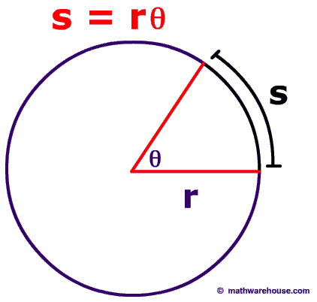
Correspondence of linear and angular mechanics
Recall the correspondence of linear and angular mechanics
Quantities | Linear | Angular
Displacement | X (m) = rθ | θ (radian)
Velocity | V (m/s) = rω | ω (1/s)
Tangential Acceleration | a (m/s²) = rα | α (1/s²)
Mass/Moment of Inertia | M (kg) | I (kg∙m²)
Force/Torque | F (N) | τ (N-m) = rFsinθ
Laws / Formulas | Linear | Angular
Newton’s 2nd Law | F=ma | τ=Iα
Constant Acceleration motion | x(t)=x₀+v₀t+1/2at² | θ(t)=θ₀+ω₀t+1/2αt²

Slide 3
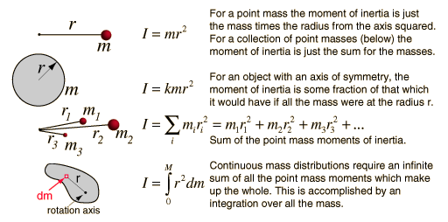
Moment of Inertia
A quantity measures an object's resistance to being accelerated by a torque relative to a given axis
It depends on both amount of mass and its spatial distribution
The resemblance to mass in linear motion
For a point mass:
r is the distance to rotation axis
For arbitrary shape:

Slide 4
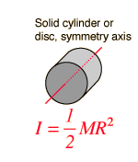
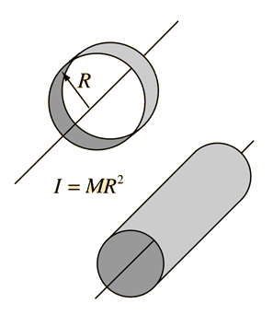
Moment of Inertia
For axis through the center of a cylinder:
For a hoop:
You’ll need this in lab manual question

Slide 5
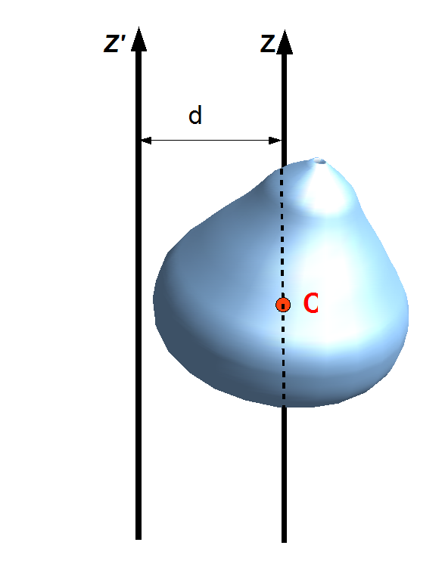

Parallel Axis Theorem
For the new moment of inertia relative to a new axis which is parallel to the original axis through the center of mass, there’s a simple relation:
$I={I }_{cm}+Md^{2}$,
d is the distance between two axis's
You will need this in lab manual question

Slide 6
Experiment Outline
This experiment is exactly the angular version of Newton’s second Law Lab
Data Table
Measure parameters of this system
Quantify the friction torque of the system
Part 1: Measure moment of inertia without extra weight
Part 2: Measure moment of inertia with extra weight

Slide 7

Measure Parameters
Measure the diameter of the axle${=2r}_{axle}$ , with Vernier caliper
Height from the drop point to the ground: h
Summation of mass of three cylinders: M
Distance from the center of the apparatus to where the cylinders are fixed on: d
Radius of cylinder(needed in lab manual question): r_{c}

Slide 8

Quantify the Friction Torque
Put a string onto the axle through the pulley, make sure you are in the correct side that make the string straight
Spin the string
Start with 2g, find enough mass: m_{f} to balance the friction torque, making the hanging mass move without acceleration
$τ_{f}=r_{axle}m_{f}g$

Slide 9
Measure Moment of Inertia Without Extra Weight
Remove friction mass
Put on a 50g hanger = m
Pull the bottom of the hanger to the dropping point, check by sticking out a ruler
Release and measure the time for it to land
Do three trials and take average value: t
Change to total 100g and repeat

Slide 10
Measure Moment of Inertia With Extra Weight
Screw three cylinder to the apparatus, make sure the screw don’t stick out downwards
Quantify friction torque again
Repeat the previous slide

Slide 11
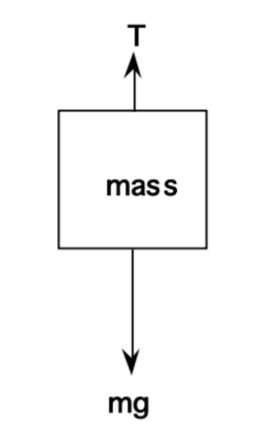

Calculations
Friction Torque: $τ_{f}=r_{axle}m_{f}g$
Angular acceleration: $\frac{h}{r}=\frac{1}{2}αt^{2}=θ$
Tension on the string: $mg−T=ma=mrα$
Applied torque: $τ=rT$
Net torque: $τ_{net}=τ−τ_{f}$
Moment of Inertia added: $∆I=3MR^{2}$
Treated as point masses here, ignored $I_{cm}$

Slide 12



Plot
This in an important part of your result
Two sets of data for different moment of inertia
“New Data Set”
(0,0)
Linear fit to get 2 measured moment of inertia
$$τ_{net}$$
$$α$$
$$τ_{net}=Iα$$

Slide 13
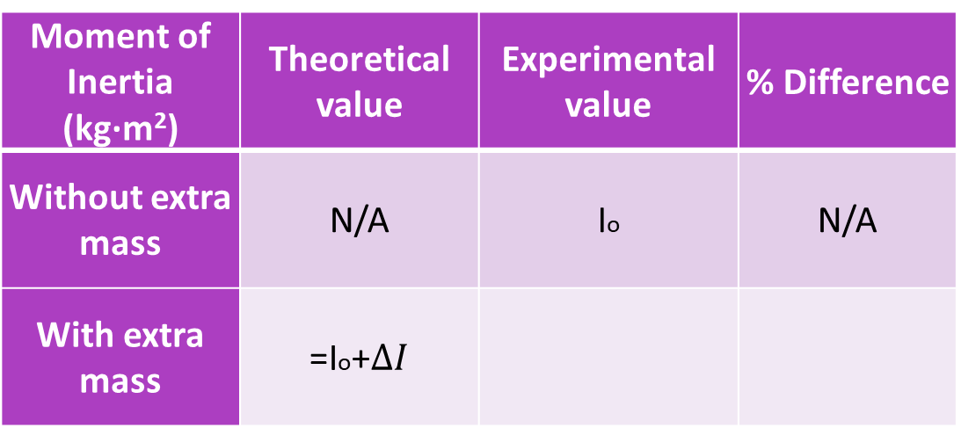
Result Presentation (100 pt)
Qualitative description of the result plot
Moment of Inertia (kg∙m²) | Theoretical value | Experimental value | % Difference
Without extra mass | N/A | Io | N/A
With extra mass | =Io+$∆I$

